Slide 1
컴퓨터 네트워크 Computer Networks and Internets, 6e

Slide 2
PART III Packet Switching and Network Technologies An overview of packet switching and packet technologies that use wired and wireless media
© Pearson Education Inc., Upper Saddle River, NJ. All rights reserved.
2
Notes:
2

Slide 3
Solving Problems
1. A synchronous TDM combining 10 digital sources, each of 800bps. Each output slot carries 8 bits from each source, but one extra bit(framing bit) is added to each frame.
2. Compare the throughput of the following transmissions.
a) parallel vs. serial b) FDM vs. TDM
c) full-duplex vs. half-duplex d) synchronous vs. asynchronous
3. Explain the multiplexing method used in ADSL.
© Pearson Education Inc., Upper Saddle River, NJ. All rights reserved.
3
Notes:
3

Slide 4
Chapter 13 Local Area Networks: Packets, Frames, and Topologies
© Pearson Education Inc., Upper Saddle River, NJ. All rights reserved.
4
Notes:
4

Slide 5
13.1 Introduction
This chapter
begins the part of the text that examines packet switching and computer network technologies
explains the IEEE standards model
concentrates on the concepts of hardware addressing and frame identification
Later chapters
expand the discussion by considering the use of packets in Wide Area Networks
cover a variety of wired and wireless networking technologies that accept and deliver packets
© Pearson Education Inc., Upper Saddle River, NJ. All rights reserved.
5
Notes:
5

Slide 6
Networks
Distinct from physical communication systems
Attach multiple endpoints
Two broad categories
Circuit switched
Packet switched
© Pearson Education Inc., Upper Saddle River, NJ. All rights reserved.
6
Notes:
6

Slide 7
Circuit Switched Networks
Provide point-to-point communication between pairs of endpoints
Establish path between sender and receiver
Separate steps for circuit creation, use, and termination
Performance equivalent to an isolated physical path
Circuit can be
Permanent/ provisioned (left in place for long periods)
Switched (created on demand)
Concept: user leases piece of underlying infrastructure for a time period
© Pearson Education Inc., Upper Saddle River, NJ. All rights reserved.
7
Notes:
7

Slide 8
Packet Switched Networks
Form the basis for the Internet
Multiplex communication over shared media
All data divided into packets (maximum size fixed)
After sending one packet, sender allows others a chance to transmit before sending a second packet
Arbitrary, asynchronous communication
No set-up required before communication begins
Performance varies due to statistical multiplexing
Concept: underlying infrastructure is shared among users
© Pearson Education Inc., Upper Saddle River, NJ. All rights reserved.
8
Notes:
8

Slide 9
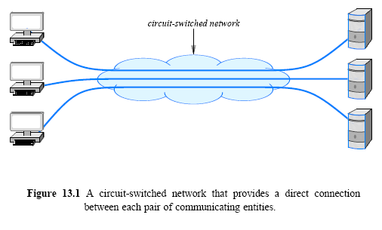
13.2 Circuit Switching
Circuit switching provides 1-to-1 dedicated connections
© Pearson Education Inc., Upper Saddle River, NJ. All rights reserved.
9
Notes:
9

Slide 10
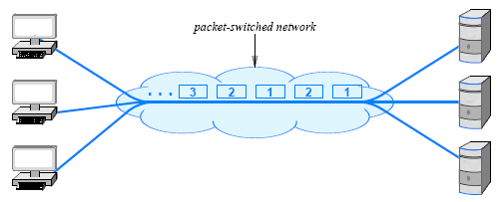
13.3 Packet Switching
Packet switching provides statistical TDM sharing
© Pearson Education Inc., Upper Saddle River, NJ. All rights reserved.
10
Notes:
10

Slide 11
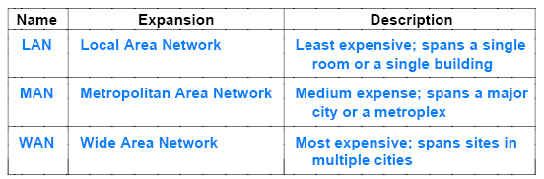
Categories Of Packet Switched Networks
Packet switching technologies are commonly classified according to the distance they span
LAN, MAN, WAN
PAN, SAN(storage), CAN(chip)
Below summarizes the terminology used
© Pearson Education Inc., Upper Saddle River, NJ. All rights reserved.
11
Notes:
11

Slide 12
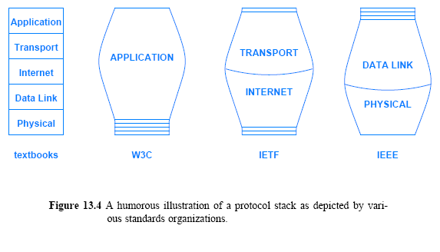
13.5 Standards for Packet Format and Identification
© Pearson Education Inc., Upper Saddle River, NJ. All rights reserved.
12
Notes:
12

Slide 13
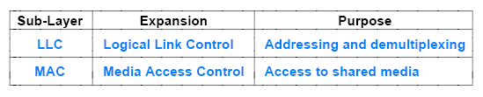
13.6 IEEE 802 Model and Standards
IEEE Project 802 (LAN/MAN standards committee)
divides Layer 2 of the protocol stack into two conceptual sub-layers,
The Logical Link Control (LLC)
sublayer specifies addressing and the use of addresses for demultiplexing as described later in the chapter
The Media Access Control (MAC)
sublayer specifies how multiple computers share underlying medium
© Pearson Education Inc., Upper Saddle River, NJ. All rights reserved.
13
Notes:
13

Slide 14
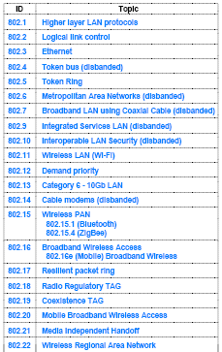
Figure 13.6
Examples of the identifiers IEEE has assigned to various LAN
standards
© Pearson Education Inc., Upper Saddle River, NJ. All rights reserved.
14
Notes:
14

Slide 15
Standards Define
Network topology (shape)
Endpoint addressing scheme
Frame (packet) format
Media access mechanism
Physical layer aspects and wiring
© Pearson Education Inc., Upper Saddle River, NJ. All rights reserved.
15
Notes:
15

Slide 16
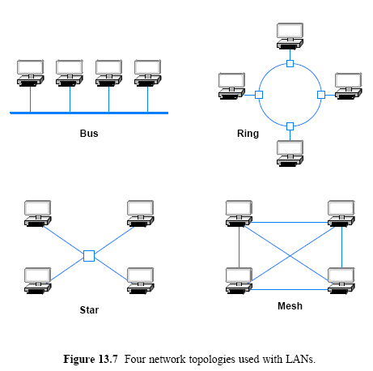
13.8 LAN Topologies
© Pearson Education Inc., Upper Saddle River, NJ. All rights reserved.
16
Notes:
16

Slide 17
13.8 LAN Topologies 13.8.5 The Reason for Multiple Topologies
Each topology has advantages and disadvantages
A ring makes it easy for computers to coordinate access and to detect whether the network is operating correctly
However, an entire ring network is disabled if one of the cables is cut
A star helps protect the network from damage to a single cable because each cable connects only one machine
A bus requires fewer wires than a star, but has the same disadvantage as a ring
a network is disabled if someone accidentally cuts the main cable
Later chapters that describe specific network technologies provide additional details about differences
© Pearson Education Inc., Upper Saddle River, NJ. All rights reserved.
17
Notes:
17

Slide 18
Assignment
Name the two sublayers of Layer 2 protocol defined by IEEE, and give the purpose of each.
What are the characteristics of LANs and WANs?
Send your solution to me by email. (Due date: 4.18. )
This assignment will be used to check your attendance.
© Pearson Education Inc., Upper Saddle River, NJ. All rights reserved.
18
Notes:
18

Slide 19
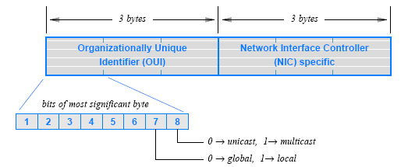
IEEE Standard For Addressing
IEEE Media Access Control address(MAC address)
Informally called an Ethernet address
Assigned to Network Interface Card (NIC)
there is a 3-byte Organizationally Unique ID (OUI)
OUI identifies the equipment vendor
a 3-byte block that identifies a particular NIC
© Pearson Education Inc., Upper Saddle River, NJ. All rights reserved.
19
Notes:
19

Slide 20
Review (Solving Problems)
Show the rate at which two digital voice data are sent using the PCM in the same digital telephone system?
2. How CRC and checksum are produced in the real protocol?
Why is CRC located at the tail of the packet?
Why is Checksum located at the header of the packet?
3. What can a RAC scheme achieve that a single parity bit scheme cannot?

Slide 21
Review
The fundamental abstraction used to collect protocols into a unified whole is known as a ( )
All aspects of a communication problem can be partitioned into pieces that work together
each piece is known as a ( )
Internet protocols use a ( )-layer reference model
How can a pair of applications that run on two independent computers coordinate to guarantee that they request a connection at the same time?
=>The answer lies in a form of interaction known as the ( )
A ( ) starts first and awaits contact
A ( ) starts second and initiates the connection
4. Explain the multiplexing method used in ADSL.

Slide 22
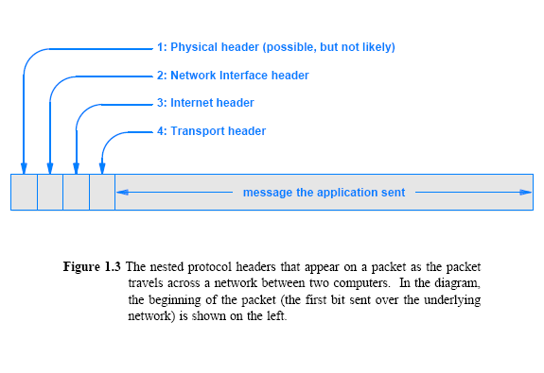
Headers and Layers

Slide 23
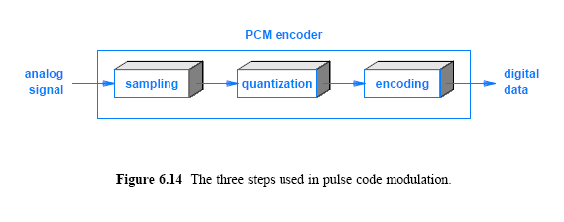
Review
How many times the signal can change per second, which is defined as the ( )
the use of high-frequency signals to carry information
asynchronous vs. synchronous communication
Full duplex vs. half duplex
Multiplexing

